Slide 1


Python Coding Session Numpy
Introduction to Implementation Details and Usage

Slide 2

Introduction
NumPy is a foundational library for numerical and scientific computing in Python. It introduces the ndarray (n-dimensional array) object, enabling efficient storage and manipulation of homogeneous data across different dimensions.

Slide 3
Introduction
Arrays: Create and manipulate n-dimensional arrays efficiently.
Math Operations: Perform element-wise arithmetic, trigonometry, and more.
Linear Algebra: Matrix operations, eigenvalues, and more.
Statistics: Mean, median, correlation, and more.
Broadcasting: Effortless operations on arrays of different shapes.
Random Numbers: Generate random values for simulations.
FFT: Fast Fourier Transform for signal processing.
Polynomials: Work with polynomials, roots, and more.
File I/O: Read/write arrays from/to files.
Memory Management: Efficient handling of array memory.
Performance: Speed up computations with C/Fortran implementations.
Integration: Integral to scientific and data libraries.

Slide 4
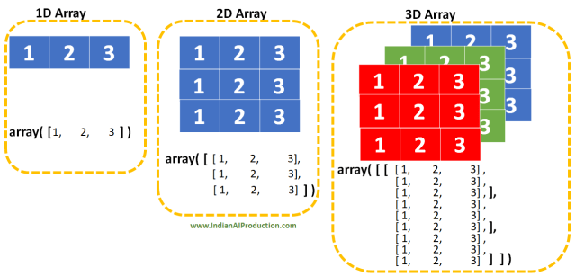
Introduction
In essence, NumPy is a core tool for scientific computing in Python, providing a robust array framework, efficient mathematical operations, and support for various data manipulation tasks. Its versatility and performance make it essential for researchers, data scientists, and engineers working on a wide range of numerical applications.

Slide 5

Introduction

Slide 6
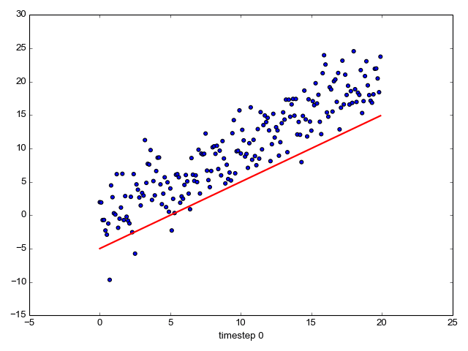
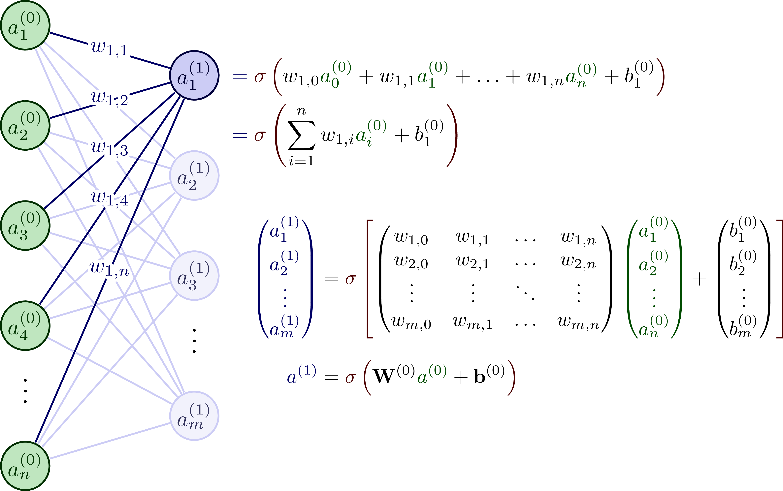
Introduction
Linear Regression
Artificial Neural Network Feed Foward

Slide 7
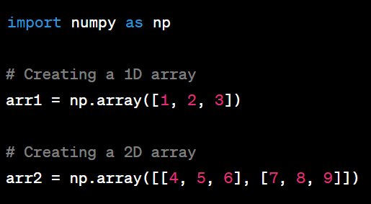
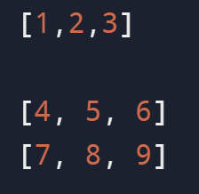
Operations with Numpy
Creating Array

Slide 8
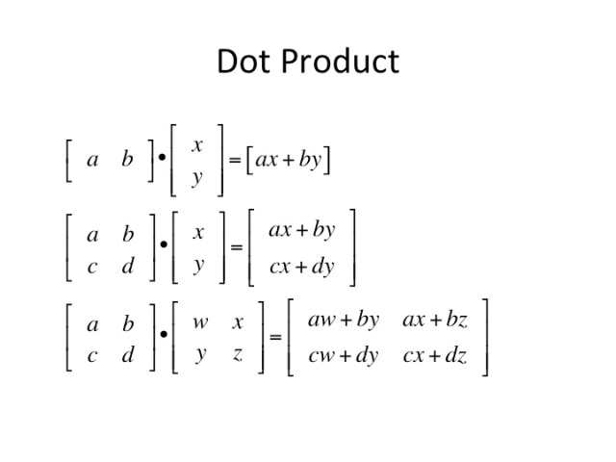
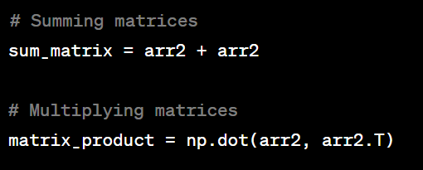
Operations with Numpy
Summing and Multiplying matrices

Slide 9
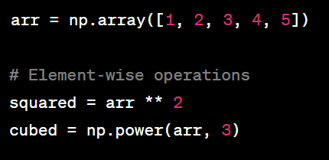
Example of RegEx
Element-Wise Operations:

Slide 10
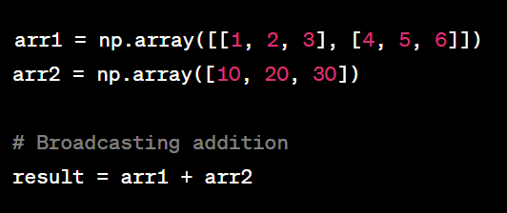
Example of RegEx
Array Broadcasting:

Slide 11
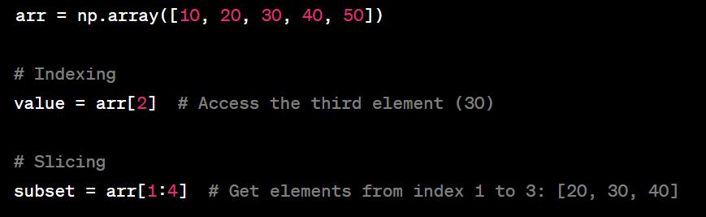
Example of RegEx
Indexing and Slicing

Slide 12
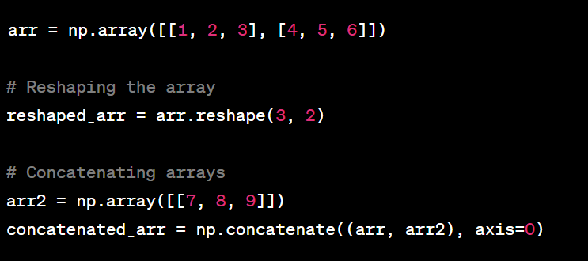
Example of RegEx
Array Manipulation

Slide 13
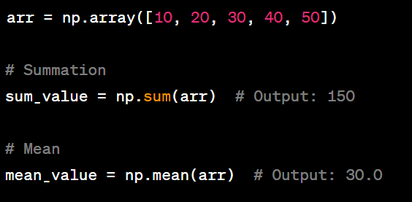
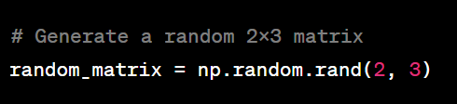
Example of RegEx
Aggregation and Reduction

Slide 14
Example of RegEx
Random Number Generation

